Slide 1
File system
The file system consists of two distinct parts: a collection of files, each storing related data, and a directory structure, which organizes and provides information about all the files in the system.
10.1 File Concept
A file is a named collection of related information that is recorded on secondary storage.
Commonly, files represent programs (both source and object) and data. Data files may be numeric, alphabetic, alphanumeric, or binary.
In general, a file is a sequence of bits, bytes, lines, or records, the meaning of which is defined by the file's creator and user.
The information in a file is defined by its creator. Many types of info. may be stored in a file-source programs, object programs, executable programs, numeric data, text, payroll records, graphic images, sound recordings, and so on.
A file has a certain defined structure which depends on its type. A text file is a sequence of characters organized into lines (and possibly pages). A source file is a sequence of subroutines and functions, each of which is further organized as declarations followed by executable statements. An object file is a sequence of bytes organized into blocks understandable by the system's linker. An executable file is a series of code sections that the loader can bring into memory and execute.

Slide 2
10.1.1 File Attributes
A file is referred by its name. A name is usually a string of characters, such as example.c. Some systems differentiate between uppercase and lowercase characters in names, whereas other systems do not.
A file's attributes vary from one OS to another :
Name: Symbolic file name is the only information kept in human readable form.
Identifier: This unique tag, usually a number, identifies the file within the file system; it is the non-human-readable name for the file.
Type: This information is needed for systems that support different types of files.
Location: This information is a pointer to a device and to the location of the file on that device.
Size: The current size of the file (in bytes, words, or blocks) and possibly the maximum allowed size are included in this attribute.
Protection: Access-control information determines who can do reading, writing, executing, and so on.
Time, date, and user identification: This information may be kept for creation, last modification, and last use. These data can be useful for protection, security, and usage monitoring.

Slide 3
10.1.1 File Attributes
A file is named, for the convenience of its human users, and is referred to by its name. A name is usually a string of characters, such as example.c. Some systems differentiate between uppercase and lowercase characters in names, whereas other systems do not.
A file's attributes vary from one operating system to another but typically consist of these:
Name: The symbolic file name is the only information kept in human readable form.
Identifier: This unique tag, usually a number, identifies the file within the file system; it is the non-human-readable name for the file.
Type: This information is needed for systems that support different types of files.
Location: This information is a pointer to a device and to the location of the file on that device.
Size: The current size of the file (in bytes, words, or blocks) and possibly the maximum allowed size are included in this attribute.
Protection: Access-control information determines who can do reading, writing, executing, and so on.
Time, date, and user identification: This information may be kept for creation, last modification, and last use. These data can be useful for protection, security, and usage monitoring.

Slide 4
Continued…
The implementation of the open() and close() operations is more complicated in an environment where several processes may open the file simultaneously.
several pieces of information are associated with an open file.
File pointer: On systems that do not include a file offset as part of the read() and write() system calls, the system must track the last read write location as a current-file-position pointer. This pointer is unique to each process operating on the file and therefore must be kept separate from the on-disk file attributes.
File-open count: As files are closed, the operating system must reuse its open-file table entries, or it could run out of space in the table. Because multiple processes may have opened a file, the system must wait for the last file to close before removing the open-file table entry. The file-open counter tracks the number of opens and closes and reaches zero on the last close. The system can then remove the entry.
Disk location of the file: Most file operations require the system to modify data within the file. The information needed to locate the file on disk is kept in memory so that the system does not have to read it from disk for each operation.
Access rights: Each process opens a file in an access mode. This information is stored on the per-process table so the operating system can allow or deny subsequent I/0 requests.

Slide 5
10.1.3 File Types
The system uses the extension to indicate the type of the file and the type of operations that can be done on that file. Only a file with a .com, .exe, or .bat extension can be executed, for instance. The .com and .exe files are two forms of binary executable files, whereas a .bat file is a containing, in ASCII format, commands to the operating system.

Slide 6
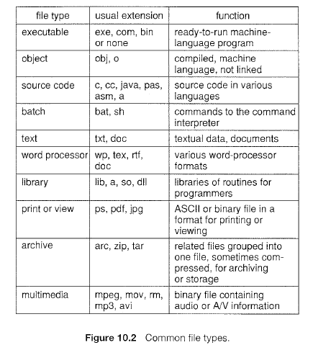
Continued…

Slide 7
10.2 Access Methods
Files store information. When it is used, this information must be accessed and read into computer memory. The information in the file can be accessed in several ways. Some systems provide only one access method for files. Other systems, such as those of IBM, support many access methods, and choosing the right one for a particular application is a major design problem.
Access methods are
Sequential access
Direct access
Other Access Methods
Indexed access
10.2.1 Sequential Access
The simplest access method is sequential access. Information in the file is processed in order, one record after the other. This mode of access is by far the most common; for example, editors and compilers usually access files in this fashion.
Reads and writes make up the bulk of the operations on a file. A read operation-read next-reads the next portion of the file and automatically advances a file pointer, which tracks the I/O location. Similarly, the write operation-write next-appends to the end of the file and advances to the end of the newly written material (the new end of file). Such a file can be reset to the beginning; and on some systems, a program may be able to skip forward or backward n records for some integer n-perhaps only for n = 1. Sequential access, which is depicted in Figure 10.3, is based on a tape model of a file and works as well on sequential-access devices as it does on random-access ones.

Slide 8
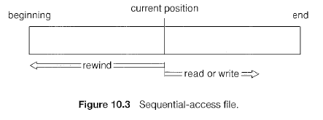
Continued…

Slide 9
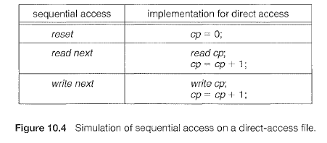
10.2.2 Direct Access
A file is made up of fixed length logical records that allow programs to read and write records rapidly in no particular order. The direct-access method is based on a disk model of a file, since disks allow random access to any file block.
For direct access, the file is viewed as a numbered sequence of blocks or records. Thus, we may read block 14, then read block 53, and then write block 7. There are no restrictions on the order of reading or writing for a direct-access file.
Direct-access files are of great use for immediate access to large amounts of information. Databases are often of this type. When a query concerning a particular subject arrives, we compute which block contains the answer and then read that block directly to provide the desired information.
For the direct-access method, the file operations must be modified to include the block number as a parameter. Thus, we have read n, where n is the block number, rather than read next, and write n rather than write next.

Slide 10
Continued…
The block number provided by the user to the operating system is normally is a relative block number. A relative block number is an index relative to the beginning of the file. Thus, the first relative block of the file is 0, the next is 1, and so on, even though the absolute disk address may be 14703 for the first block and 3192 for the second. The use of relative block numbers allows the operating system to decide where the file should be placed. and helps to prevent the user from accessing portions of the file system that may not be part of her file. Some systems start their relative block numbers at 0; others start at 1.

Slide 11
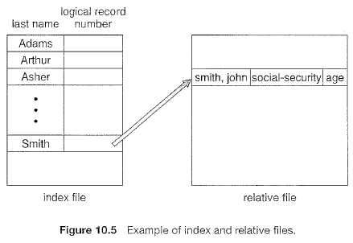
10.2.3 Other Access Methods
Other access methods can be built on top of a direct-access method. These methods generally involve the construction of an index for the file. The index like an index in the back of a book contains pointers to the various blocks. To find a record in the file, we first search the index and then use the pointer to access the file directly and to find the desired record.
Example
For example, IBM's indexed sequential-access method (ISAM) uses a small master index that points to disk blocks of a secondary index. The secondary index blocks point to the actual file blocks. The file is kept sorted on a defined key. To find a particular item, we first make a binary search of the master index, which provides the block number of the secondary index. This block is read in, and again a binary search is used to find the block containing the desired record. Finally, this block is searched sequentially. In this way, any record can be located from its key by at most two direct-access reads. Figure 10.5 shows a similar situation as implemented by VMS index and relative files.

Slide 12
10.3 Directory structure
Some systems store millions of files on terabytes of disk. To manage all these data, we need to organize them. This organization involves the use of directories. In this section, we explore the topic of directory structure.
10.3.1 Storage Structure
A disk (or any storage device that is large enough) can be used in its entirety for a file system. Sometimes, though, it is desirable to place multiple file systems on a disk or to use parts of a disk for a file system and other parts for other things, such as swap space or unformatted (raw) disk space.
These parts are known variously as partitions, slices, or (in the IBM world) minidisks. A file system can be created on each of these parts of the disk. As we shall see in the next chapter, the parts can also be combined to form larger structures known as volumes, and file systems can be created on these as well.
Each volume that contains a file system must also contain information about the files in the system. This information is kept in entries in a device directory or volume table of contents.

Slide 13
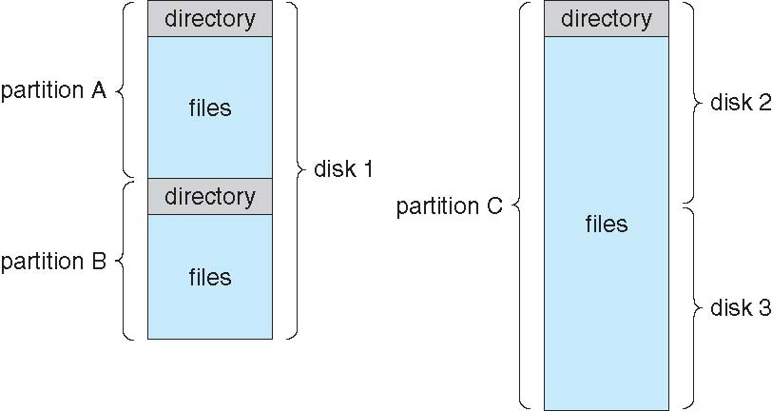
A Typical File-system Organization
Notes:
13

Slide 14
10.3.2 Directory Overview
When considering a particular directory structure, we need to keep in mind the operations that are to be performed on a directory:
Search for a file. We need to be able to search a directory structure to find the entry for a particular file. Since files have symbolic names and similar names may indicate a relationship between files, we may want to be able to find all files whose names match a particular pattern.
Create a file. New files need to be created and added to the directory.
Delete a file. When a file is no longer needed, we want to be able to remove it from the directory.
List a directory. We need to be able to list the files in a directory and the contents of the directory entry for each file in the list.
• Rename a file. Because the name of a file represents its contents to its users, we must be able to change the name when the contents or use of the file changes.
Traverse the file system. We may wish to access every directory and every file within a directory structure. For reliability, it is a good idea to save the contents and structure of the entire file system at regular intervals. Often, we do this by copying all files to magnetic tape. This technique provides a backup copy in case of system failure.

Slide 15
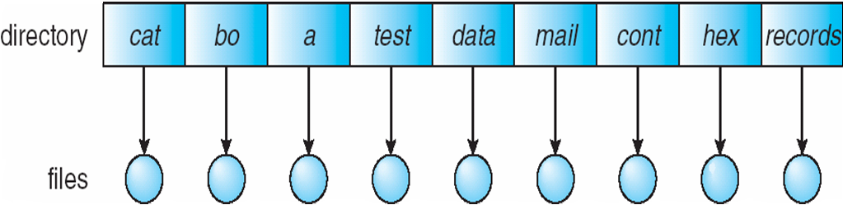
10.3.3 Single-Level Directory
The simplest directory structure is the single-level directory. All files are contained in the same directory, which is easy to support and understand.
A single-level directory has significant limitations, however, when the number of files increases or when the system has more than one user. Since all files are in the same directory, they must have unique names. If two users call their data file test, then the unique-name rule is violated. For example, in one programming class, 23 students called the program for their second assignment progl; another 11 called i\ assign!. Although file names are generally selected to reflect the content of the file, they are often limited in length, complicating the task of making file names unique.
Even a single user on a single-level directory may find it difficult to remember the names of all the files as the number of files increases.

Slide 16
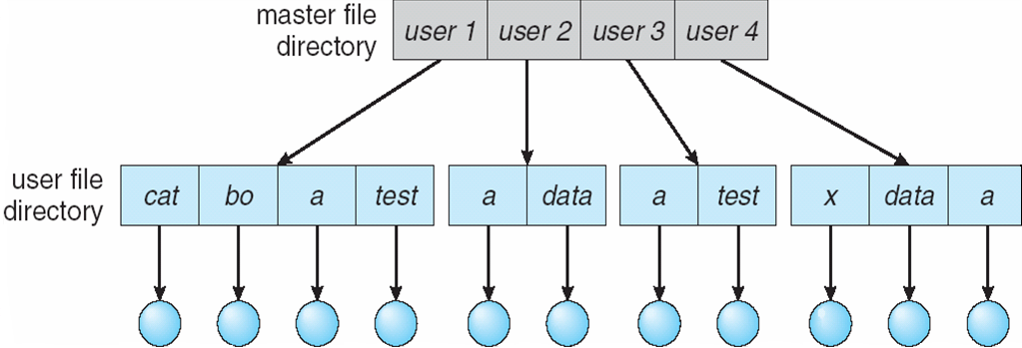
10.3.4 Two-Level Directory
In the two-level directory structure, each user has his own user file directory (UFD). The UFDs have similar structures, but each lists only the files of a single user. When a user job starts or a user logs in, the system's master file directory (MFD) is searched. The MFD is indexed by user name or account number, and each entry points to the UFD for that user
When a user refers to a particular file, only his own UFD is searched. Thus, different users may have files with the same name, as long as all the file names within each UFD are unique. To create a file for a user, the operating system searches only that user's UFD to ascertain whether another file of that name exists. To delete a file, the operating system confines its search to the local UFD; thus, it cannot accidentally delete another user's file that has the same name.

Slide 17
Continued…
Disadvantage: Although the two-level directory structure solves the name-collision problem, it still has disadvantages. This structure effectively isolates one user from another. Isolation is an advantage when the users are completely independent but is a disadvantage when the users want to cooperate on some task and to access one another's files. Some systems simply do not allow local user files to be accessed by other users.
If access is to be permitted, one user must have the ability to name a file in another user's directory. To name a particular file uniquely in a two-level directory, we must give both the user name and the file name. A two-level directory can be thought of as a tree, or an inverted tree, of height 2. The root of the tree is the MFD. Its direct descendants are the UFDs. The descendants of the UFDs are the files themselves. The files are the leaves of the tree. Specifying a user name and a file name defines a path in the tree from the root (the MFD) to a leaf (the specified file).
Thus, a user name and a file name define a path name. Every file in the system has a path name. To name a file uniquely, a user must know the path name of the file desired.
For example, if user A wishes to access her own test file named test, she can simply refer to test. To access the file named test of user B (with directory-entry name userb), however, she might have to refer to /userb/test. Every system has its own syntax for naming files in directories other than the user's own.

Slide 18
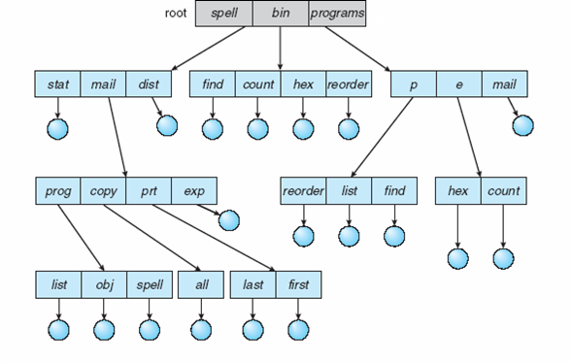
10.3.5 Tree-Structured Directories
This generalization allows users to create their own subdirectories and to organize their files accordingly. A tree is the most common directory structure. The tree has a root directory, and every file in the system has a unique path name. mail/prt

Slide 19
Continued.
A directory (or subdirectory) contains a set of files or subdirectories. A directory is simply another file, but it is treated in a special way. All directories have the same internal format. One bit in each directory entry defines the entry as a file (0) or as a subdirectory (1). Special system calls are used to create and delete directories.
In normal use, each process has a current directory. The current directory should contain most of the files that are of current interest to the process. When reference is made to a file, the current directory is searched. If a file is needed that is not in the current directory, then the user usually must either specify a path name or change the current directory to be the directory holding that file.
The initial current directory of the login shell of a user is designated when the user job starts or the user logs in. The operating system searches the accounting file (or some other predefined location) to find an entry for this user (for accounting purposes). In the accounting file is a pointer to (or the name of) the user's initial directory. This pointer is copied to a local variable for this user that specifies the user's initial current directory. From that shell, other processes can be spawned. The current directory of any subprocess is usually the current directory of the parent when it was spawned.

Slide 20
Path names can be of two types: absolute and relative. An absolute path name begins at the root and follows a path down to the specified file, giving the directory names on the path. A relative path name defines a path from the current directory.
For example, in the tree-structured file system of Figure 10.9, if the current directory is root/spell'/mail, then the relative path name prt/first refers to the same file as does the absolute path name root/spcll/mail/prt/first.
Allowing a user to define her own subdirectories permits her to impose a structure on her files. This structure might result in separate directories for files associated with different topics (for example, a subdirectory was created to hold the text of this book) or different forms of information (for example, the directory programs may contain source programs; the directory bin may store ail the binaries).

Slide 21
continued..
An interesting policy decision in a tree-structured directory concerns how to handle the deletion of a directory. If a directory is empty, its entry in the directory that contains it can simply be deleted. However, suppose the directory to be deleted is not empty but contains several files or subdirectories. One of two approaches can be taken. Some systems, such as MS-DOS, will not delete a directory unless it is empty. Thus, to delete a directory, the user must first delete all the files in that directory. If any subdirectories exist, this procedure must be applied recursively to them, so that they can be deleted also. This approach can result in a substantial amount of work. An alternative approach, such as that taken by the UNIX rm command, is to provide an option: When a request is made to delete a directory, all that directory's files and subdirectories are also to be deleted. Either approach is fairly easy to implement; the choice is one of policy.
A path to a file in a tree-structured directory can be longer than a path in a two-level directory

Slide 22
10.3.6 Acyclic-Graph Directories
Consider two programmers who are working on a joint project. The files associated with that project can be stored in a subdirectory, separating them from other projects and files of the two programmers. But since both programmers are equally responsible for the project, both want the subdirectory to be in their own directories. The common subdirectory should be shared. A shared directory or file will exist in the file system in two (or more) places at once.
A tree structure prohibits the sharing of files or directories. An acyclic graph —that is, a graph with no cycles—allows directories to share subdirectories and files.
It is important to note that a shared file (or directory) is not the same as two copies of the file. With two copies, each programmer can view the copy rather than the original, but if one programmer changes the file, the changes will not appear in the other's copy. With a shared file, only one actual file exists, so any changes made by one person are immediately visible to the other. Sharing is particularly important for subdirectories; a new file created by one person will automatically appear in all the shared subdirectories.
When people are working as a team, all the files they want to share can be put into one directory. The UFD of each team member will contain this directory of shared files as a subdirectory.

Slide 23
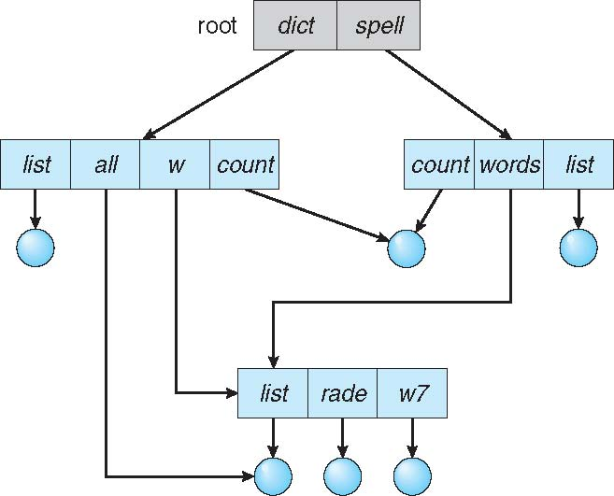
Shared files and subdirectories can be implemented in several ways. A common way, exemplified by many of the UNIX systems, is to create a new directory entry called a link. A link is effectively a pointer to another file or subdirectory. For example, a link may be implemented as an absolute or a relative path name. When a reference to a file is made, we search the directory. If the directory entry is marked as a link, then the name of the real file is included in the link information.

Slide 24
An acyclic-graph directory structure is more flexible than is a simple tree structure, but it is also more complex. Several problems must be considered carefully.
Another problem involves deletion. When can the space allocated to a shared file be deallocated and reused? One possibility is to remove the file whenever anyone deletes it, but this action may leave dangling pointers to the now-nonexistent file. Worse, if the remaining file pointers contain actual disk addresses, and the space is subsequently reused for other files.
Another approach to deletion is to preserve the file until all references to it are deleted.

Slide 25
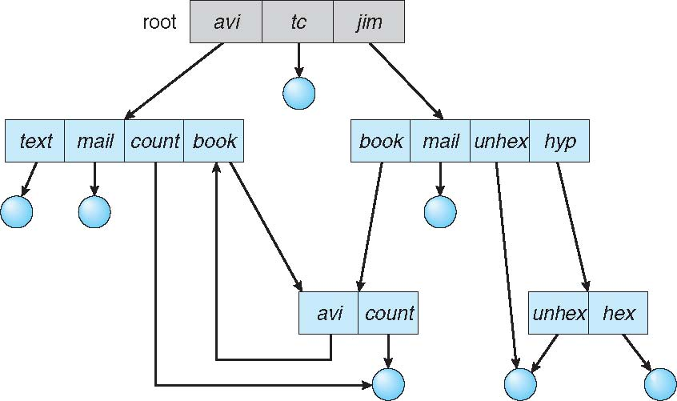
10.3.7 General Graph Directory
A serious problem with using an acyclic-graph structure is ensuring that there are no cycles. If we start with a two-level directory and allow users to create subdirectories, a tree-structured directory results. It should be fairly easy to see that simply adding new files and subdirectories to an existing tree-structured directory preserves the tree-structured nature. However, when we add links to an existing tree-structured directory, the tree structure is destroyed, resulting in a simple graph structure.

Slide 26
How do we guarantee no cycles?
Allow only links to file not subdirectories
Garbage collection
Every time a new link is added use a cycle detection algorithm to determine whether it is OK

Slide 27
10.4 File-System Mounting
Just as a file must be opened before it is used, a file system must be mounted before it can be available to processes on the system. More specifically, the directory structure can be built out of multiple volumes, which must be mounted to make them available within the file-system name space.
The mount procedure is straightforward. The operating system is given the name of the device and the mount point—the location within the file structure where the file system is to be attached. Typically, a mount point is an empty directory. For instance, on a UNIX system, a file system containing a user's home directories might be mounted as /home; then, to access the directory structure within that file system, we could precede the directory names with ftiome, as in /homc/janc. Mounting that file system under /users would result in the path name /users/jane, which we could use to reach the same directory.
Next, the operating system verifies that the device contains a valid file system. It does so by asking the device driver to read the device directory and verifying that the directory has the expected format.

Slide 28
Finally, the operating system notes in its directory structure that a file system is mounted at the specified mount point. This scheme enables the operating system to traverse its directory structure, switching among file systems as appropriate.
A unmounted file system (fig b) is mounted at a mount point(fig a).

Slide 29
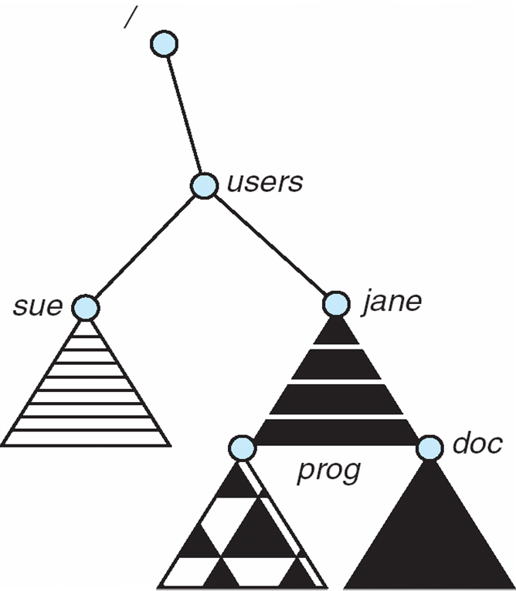
directory structure, switching among file systems as appropriate. To illustrate file mounting, consider the file system depicted in Figure, where the triangles represent subtrees of directories that are of interest. Figure (a) shows an existing file system, while Figure (b) shows an unmounted volume residing on /device'/dsk. At this point, only the files on the existing file system can be accessed. Below Figure shows the effects of mounting the volume residing on /device/dsk over /users
mount point

Slide 30
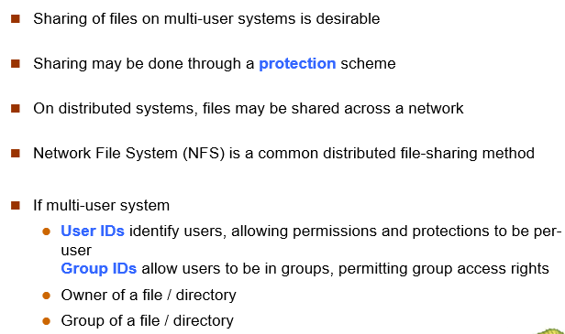
File Sharing
Multiple Users
Remort File System
Client Server Model
Distributed Information Systems
Failure Model
Consistency Smantics
Notes:
Multiple Users
RemortFIle System
Client Server Model
Distributed Information Systems
Failure Model
Consistency Smantics

Slide 31
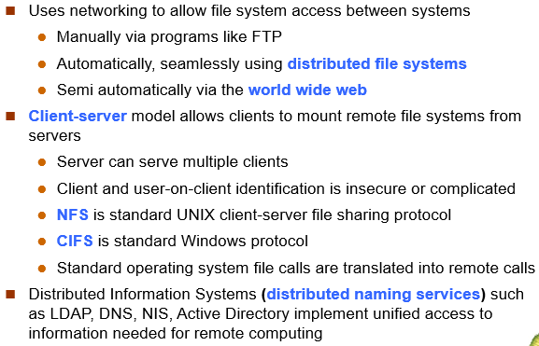
File Sharing – Remote File Systems

Slide 32
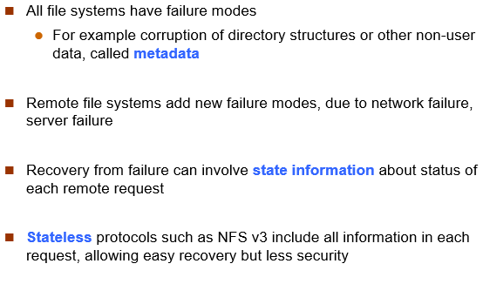

Slide 33
Protection
File owner/creator should be able to control:
what can be done
by whom
Types of access
Read
Write
Execute
Append
Delete
List

Slide 34
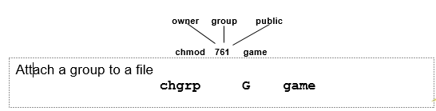
Mode of access: read, write, execute
Three classes of users on Unix / Linux
RWX
a) owner access 7 ⇒ 1 1 1 RWX
b) group access 6 ⇒ 1 1 0
RWX
c) public access 1 ⇒ 0 0 1
Ask manager to create a group (unique name), say G, and add some users to the group.
For a particular file (say game) or subdirectory, define an appropriate access.

Slide 35
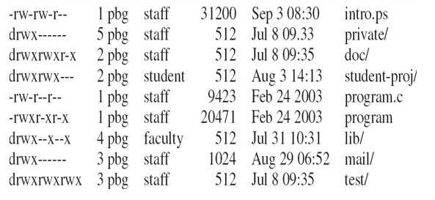
A Sample UNIX Directory Listing

